Slide 1

Sprocket Central Pty Ltd
Data analytics approach
[Division Name] - [Engagement Manager], [Senior Consultant], [Junior Consultant]

Slide 2
Agenda
Introduction
Data Exploration
Model Development
Interpretation

Slide 3
Introduction
Problem Statement:
Sprocket Central Pty Ltd , a medium size bikes & cycling accessories organisation, has given us a new list of 1000 potential customers with their demographics and attributes. (However, these customers do not have prior transaction history with the organisation.)
Our goal:
The marketing team at Sprocket Central Pty Ltd want to know about useful customer insights which could help optimise resource allocation for targeted marketing. Hence, improve performance by focusing on high value customers.
About Dataset:
Sprocket Central Pty Ltd provided us 3 datasets:
Customer Demographic
Customer Addresses
Transactions data
New Customer List (which is the target data)
Steps Taken:
Data Cleaning → Cleaned for better quality
Data Transformation → Merged the transactions, customer demographic, customer address
Data Exploration → Explore the data to reveal insights

Slide 4
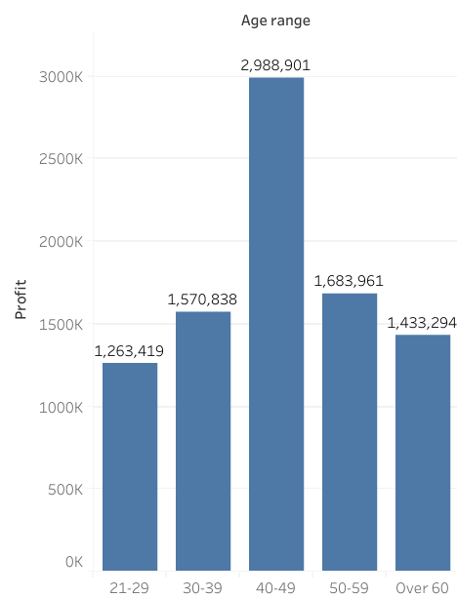
Introduction
Total Profit based on Age range
Insights:
The customers between 40 to 49 age are the most profitable in terms of recent transaction history.

Slide 5
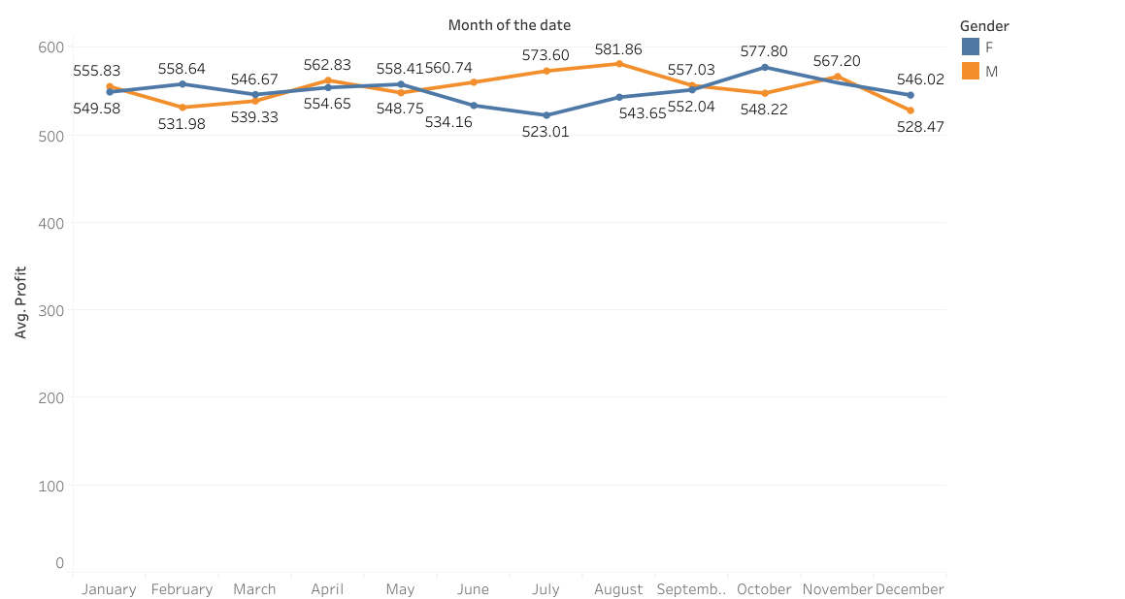
Introduction
Average Profit based on Month
Insights:
The male customers had tendency to spend more in the middle of the year from May to August most in August and reached the bottom in December
The female customers had tendency to spend more in the later half of the year from July to October - most in October and reached the bottom in July

Slide 6
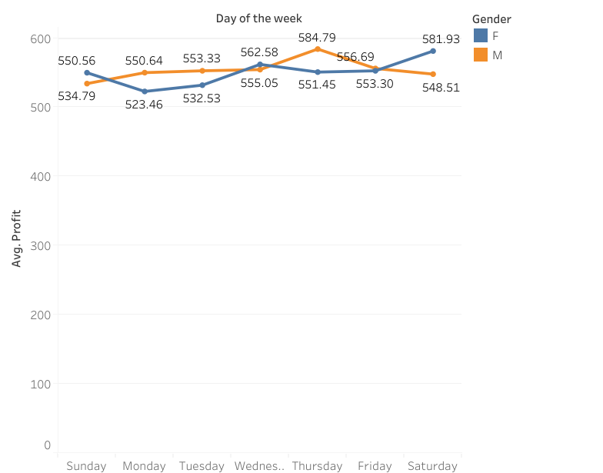
Introduction
Average Profit based on Day of the Week
Insights:
The male customers had tendency to spend most in Saturday and reached the bottom in Monday while the female customers had tendency to spend most in Thursday and reached the bottom in Sunday

Slide 7
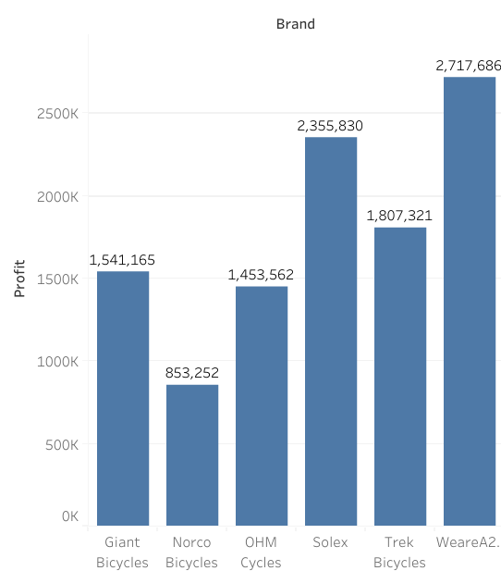
Introduction
Total Profit based on Brand
Insights:
The customers spend for the WeareA2B most in terms of recent transaction history.

Slide 8
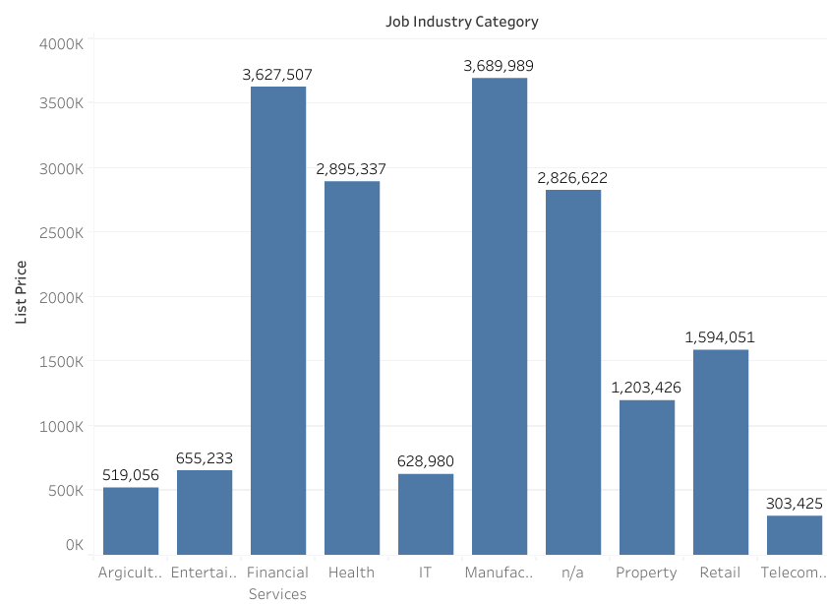
Introduction
Total Profit based on Job Industry
Insights:
The customers in Manufacturing industry and Financial Services were recorded as the two most profitable sectors (approximately as 10 times as the lowest industry - Telecommuncation).

Slide 9
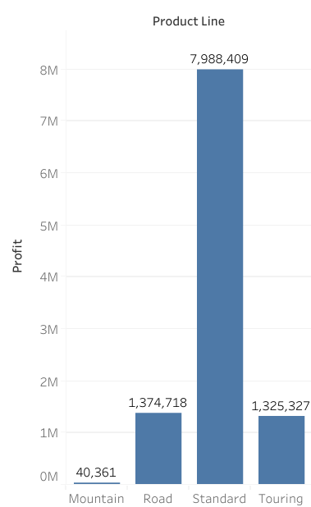
Introduction
Total Profit based on Product line
Insights:
The standard product line achieved the highest profit compared to others and more than the sum of the others product line of the company.

Slide 10
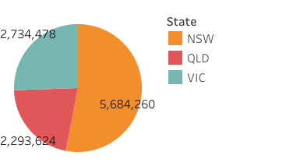
Introduction
Total Profit based on State
Insights:
The customers in New South Wales were recorded as the most profitable state among the three states and accounts for more than 50% of the profit

Slide 11
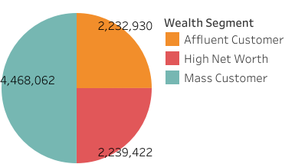
Introduction
Total Profit based on State
Insights:
The customers in Mass Customer segment were recorded as the most profitable state among the three states and accounts for approximately 50% of the profit

Slide 12
Model Development
Marketing team should deploy the targeted model based on -
Customer between age 40 to 49.
Male customers in the mid-year between May - August and in weekend around Saturday.
Female customers around October and in the middle of the week, Thursday.
Customers in the Mass Consumer Segment.
Customers related to Financial Services and Manufacturing Industries.
Focus on WeareA2B brand and Standard product as the top priority.
Customers living in New South Wales.

Slide 13
Thank you

